Slide 1
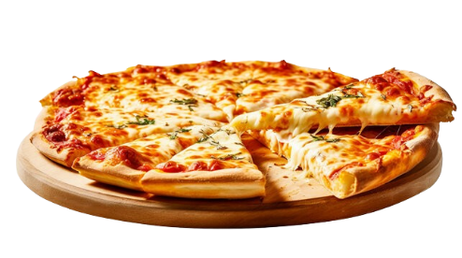
Pizza Sales Report
by Adish Khatri

Slide 2

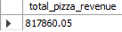
Retrieve the total number of orders placed

Slide 3
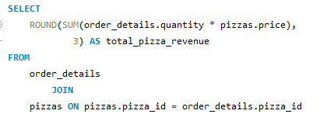
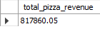
CALCULATE THE TOTAL REVENUE GENERATED FROM PIZZA SALES.
select

Slide 4
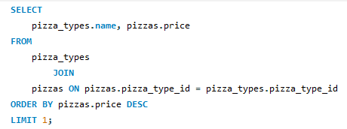
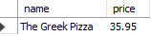
IDENTIFY THE HIGHEST-PRICED PIZZA.

Slide 5
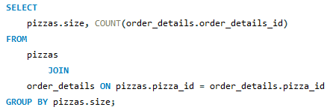
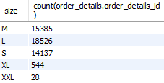
IDENTIFY THE MOST COMMON PIZZA SIZE ORDERED.

Slide 6
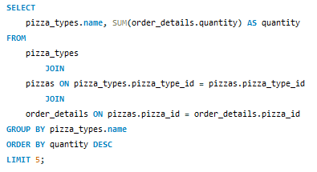
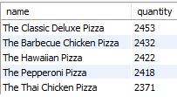
LIST THE TOP 5 MOST ORDERED PIZZA TYPES ALONG WITH THEIR QUANTITIES.

Slide 7
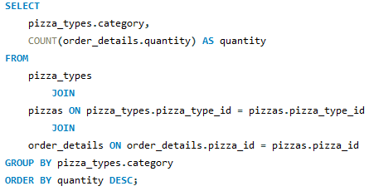
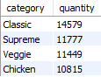
JOIN THE NECESSARY TABLES TO FIND THE TOTAL QUANTITY OF EACH PIZZA CATEGORY
ORDERED.

Slide 8
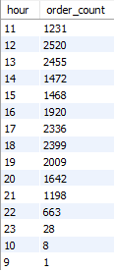
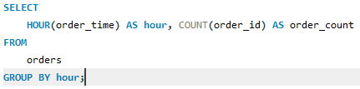
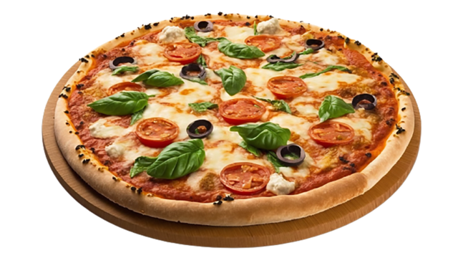
DETERMINE THE DISTRIBUTION OF ORDERS BY HOUR OF THE DAY.

Slide 9
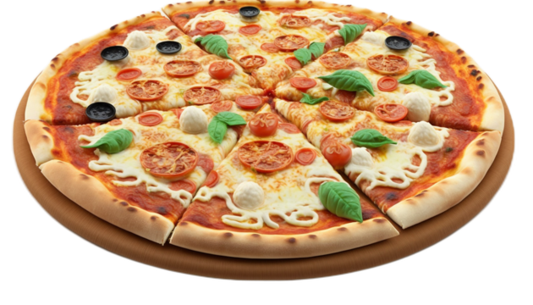
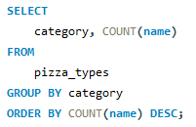
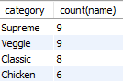
JOIN RELEVANT TABLES TO FIND THE CATEGORY-WISE DISTRIBUTION OF PIZZAS.

Slide 10
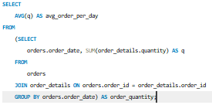
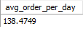
GROUP THE ORDERS BY DATE AND CALCULATE THE AVERAGE NUMBER OF PIZZAS ORDERED PER DAY.

Slide 11
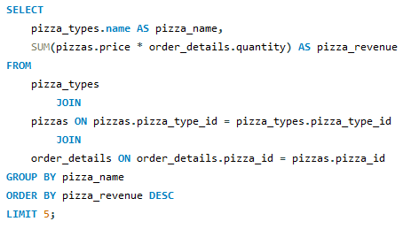
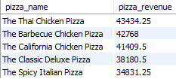
DETERMINE THE TOP 5 MOST ORDERED PIZZA TYPES BASED ON REVENUE.

Slide 12
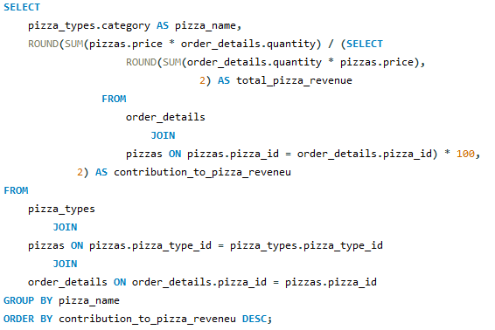
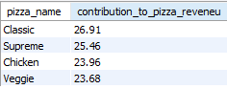
CALCULATE THE PERCENTAGE CONTRIBUTION OF EACH PIZZA TYPE TO TOTAL REVENUE.

Slide 13
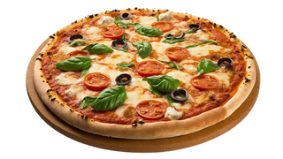
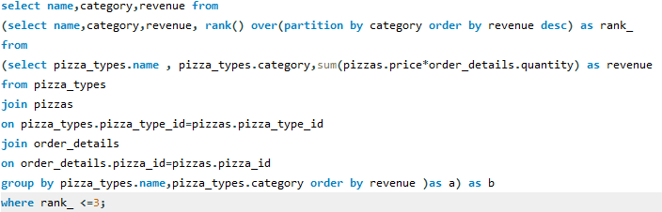
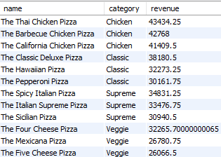
DETERMINE THE TOP 3 MOST ORDERED PIZZA TYPES BASED ON REVENUE FOR EACH PIZZA CATEGORY.

Slide 14
THANK YOU!

